Slide 1
CS 4530: Fundamentals of Software Engineering Lesson 2.2 The Architectural Scale
Jonathan Bell, Adeel Bhutta, Ferdinand Vesely, Mitch Wand
Khoury College of Computer Sciences
© 2022 Released under the CC BY-SA license
Notes:
This is Lesson 2.2: The Architectural Scale

Slide 2
Learning Goals for this Lesson
At the end of this lesson, you should be able to
Give 5 examples of software architectural styles and their distinguishing characteristics
Draw a picture or give an example to illustrate each one
Notes:
<read slide>

Slide 3
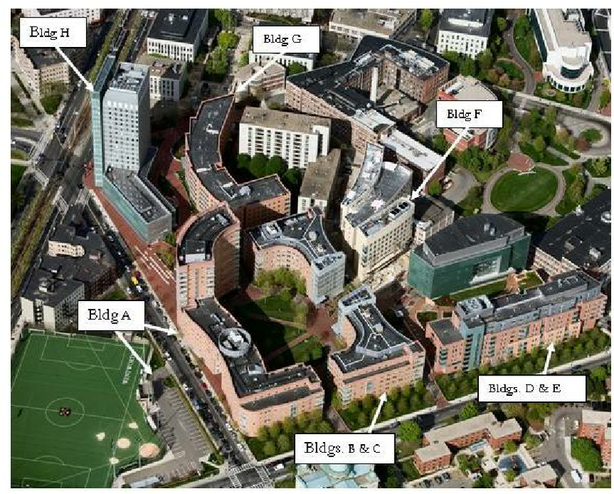
The Architectural Scale
key questions: what are the pieces? how do they fit together to form a coherent whole?
Notes:
Remember the key questions for architectural-scale design: what are the pieces? How do they fit together to form a coherent whole?

Slide 4
What do we learn at this scale?
Knowing the top-level organization gives you the first clue about
how to understand the system
where to look for bugs or explain behaviors
how to organize into teams
how to find modification and extension points
Notes:
<read slide>

Slide 5
Examples of Architectural Styles
Object-oriented
Layered
Pipeline
Microkernel
Event-driven
Notes:
In this lesson, we will look briefly at different architectural styles: <read slide>

Slide 6
Example 1: Object-Oriented Architecture
The pieces of the program correspond to entities in the real world.
Properties & operations correspond to operations in the real world
Example: solitaire:
Entities:
card
pile
layout
Operations:
find the number and suit of a card
move a card from one pile to another
check to see if a given move is legal
check to see if the layout is in a winning state
Notes:
Our first architectural style is the object-oriented architecture. In this architecture, the pieces of the program correspond to entities in the real world, and the properties and operations correspond to properties and operations of the corresponding real-world objects.
For example, in a Solitaire game, we might have…<read slide>.
This is not about the language technology that we use to implement the system. We could conceivably implement an object-oriented architecture using a language that was not itself object-oriented.

Slide 7
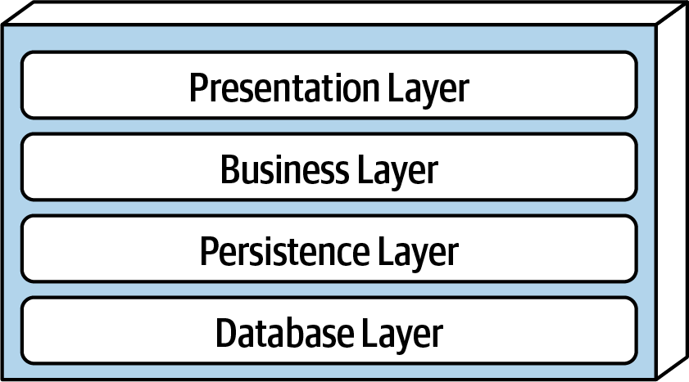
Example 2: Layered Architecture
The pieces correspond to level of concern.
Each layer depends on services from the layer or layers below
Organize teams by Layer
different layers require different expertise
When the layers are run on separate pieces of hardware, they are sometimes called "tiers"
Notes:
Our second architecture is a layered architecture. In a layered architecture, the pieces correspond to levels of concern, where each layer depends on services from the layer or layers below. This is an example of “Separation of Concerns.” For example, the Presentation Layer depends only on the data supplied by the Business Layer; it does not have to concern itself with the details of how that data is computed.
One advantage of this architecture is that the different layers typically require different areas of expertise, so in a large project one might have separate teams for each layer.
Remember that each Layer may have its own internal architecture. For example, the Presentation Layer may itself be implemented using an object-oriented architecture.

Slide 8
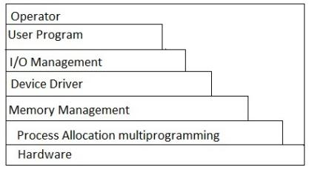
Layered Architecture (contd)
Typical organization for operating systems
Layers communicate through procedure calls and callbacks (sometimes called "up-calls")
Notes:
Layered architectures are very common in Operating Systems. You’ve probably seen pictures like this in your Operating Systems class.

Slide 9
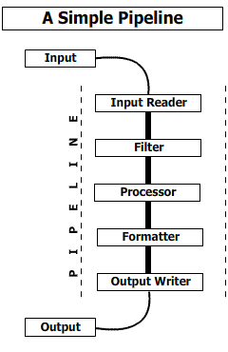
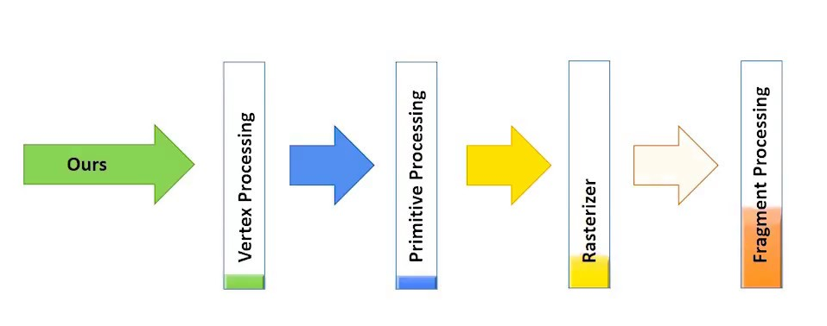
Example 3: Pipeline Architecture
The pieces correspond to stages in the transformation of data in the system
Good for complex straight-line processes, e.g. image processing
Notes:
Pipelines are a third kind of architecture. Here, the pieces correspond to steps in the transformation of some data. Each piece depends on the data produced by the preceding piece.

Slide 10
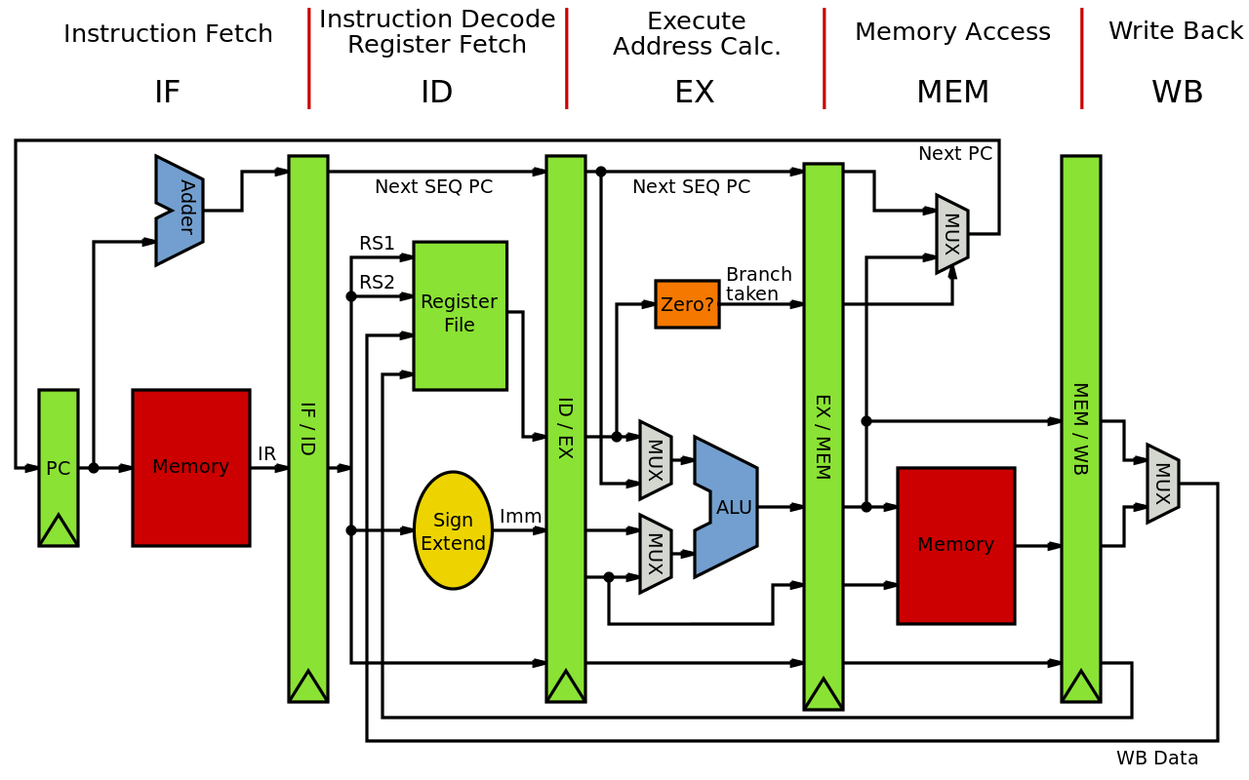
Also good for visualizing hardware
Notes:
Hardware is also commonly visualized as a pipeline.

Slide 11
How do the stages communicate?
That's the next-level decision
data-push (each stage invokes the next)
demand-pull (each stage demands data from its predecessor)
queues? buffers?
This is at the interaction scale (coming up next lesson)
Notes:
Of course, to complete the design we need to decide how the stages should communicate. Typical alternatives are data-push, where each stage invokes the next, and demand-pull, where each stage asks its predecessor for some data. Or one might have some kind of queue or buffer between the stages. But that is at the level of the Interaction Scale, coming up in the next lesson.

Slide 12
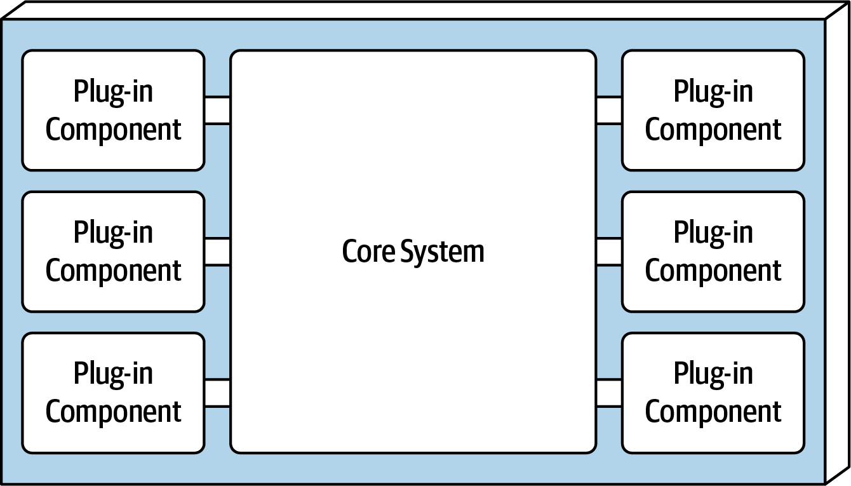
Example 4: A Plugin Architecture ("microkernel")
Components consist of
a small core (the "microkernel") for essential functions, and lots of hooks for adding other services
Plug-ins corresponding to different user functions
Highly extensible
Plug-ins can be designed by small, less-experienced teams– even by users!
Connection methods may vary
Notes:
Another common architecture is the Plug-In architecture. In this architecture, the system consists of a small core that provides essential behaviors, and also provides hooks or switches by which other modules can alter that behavior.
Additional functionality is provided by pieces called plug-ins which implement the new behaviors.

Slide 13

Analogy: Affordances
An “affordance” is a property of an object that enables some operation to be performed with/on that object
Eg: zipper handles enable opening/closing
Door handles enable opening/closing
Spouts enable pouring
In a microkernel architecture, the core contains affordances for extension
These affordances may have many possible forms

Slide 14
Plugin Examples
Many examples:
Visual Studio Code (internal org. + extension marketplace)
emacs (emacs-lisp + hooks)
git clients
$ ls .git/hooks
applypatch-msg.sample pre-applypatch.sample pre-rebase.sample
commit-msg.sample pre-commit.sample pre-receive.sample
fsmonitor-watchman.sample prepare-commit-msg.sample update.sample
post-update.sample pre-push.sample
Notes:
Many popular systems use this architecture. Visual Studio Code uses this architecture to allow users to build popular extensions. Emacs-lisp provides hook functions that can be overridden by the user. Git provides modifications by allowing the user to substitute their own file in place of the 11 files listed.

Slide 15
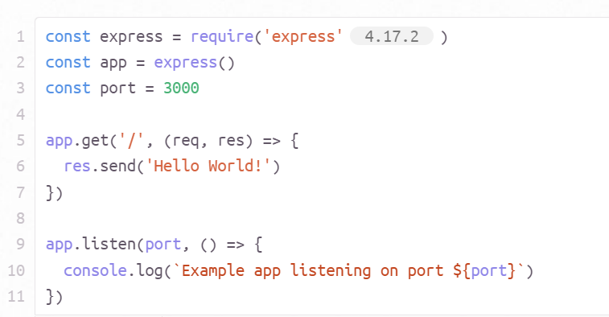
Express.js provides methods for modifying its built-in actions
https://expressjs.com/en/starter/hello-world.html
Notes:
Express.js, the Javascript web server that we will be using in this course, provides affordances in the form of methods that add actions to its built-in operations. Here we’ve constructed an empty server. This server (a thing in the real world!) is represented by an object (here called ‘app’). This object provides public methods for changing the behavior of the server it represent. Here the call ‘app.get’ allows us to specify the behavior of the empty server when it receives a request to the root URL ‘/’.

Slide 16
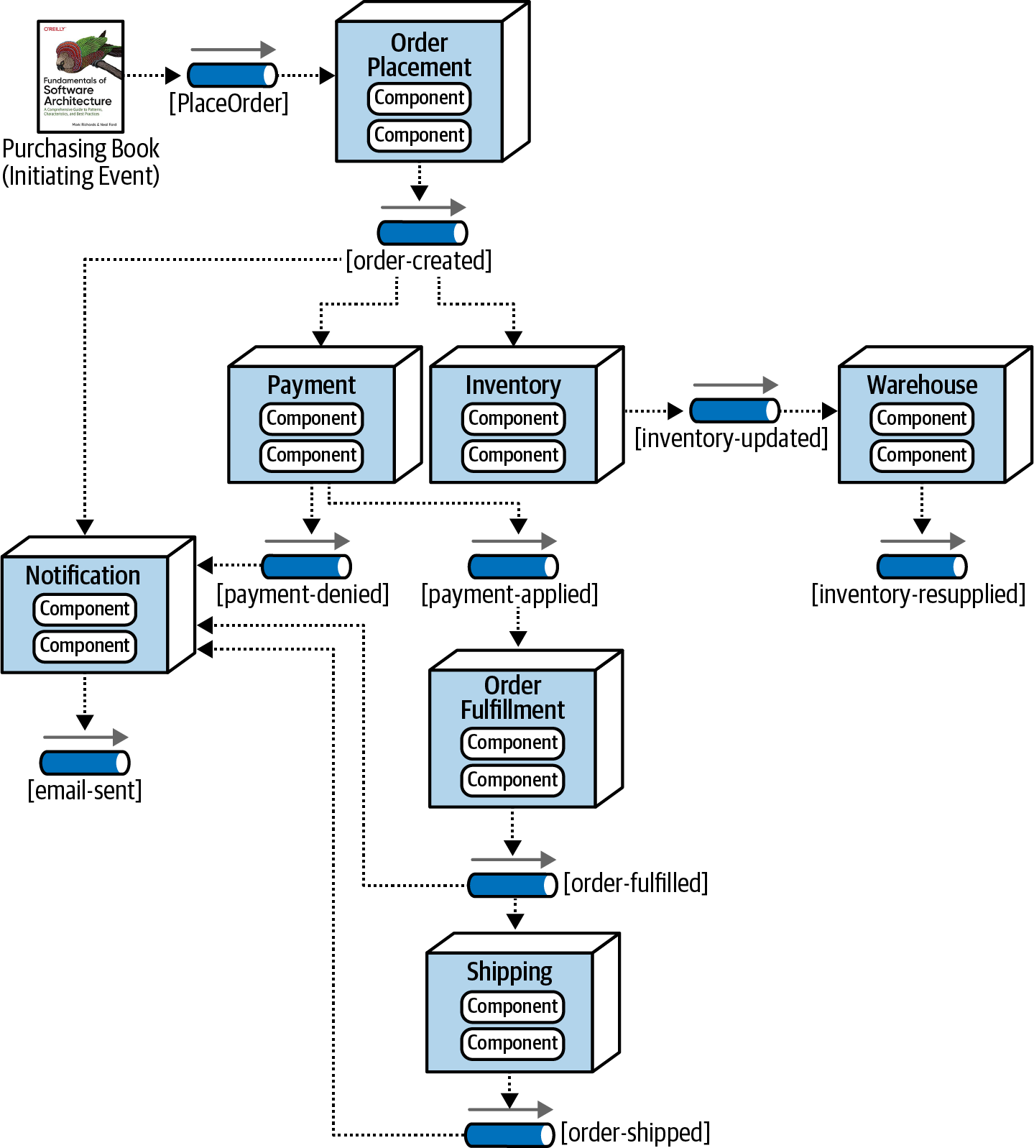
Example 5: Event-Driven Architecture
Metaphor: a bunch of bureaucrats shuffling papers
Components correspond to stages in the flow of data through the system (not necessarily a straight-line flow)
Each processing unit has an in-box and one or more out-boxes
Each unit takes a task from its inbox, processes it, and puts the results in one or more outboxes.
Stages are typically connected by asynchronous message queues.
Conditional flow
Notes:
Our last example architecture is an event-driven architecture. This is like a pipeline architecture, except that data may take one of many paths through the system. Each processing unit has an in-box and one or more out-boxes, which are typically asynchronous message queues.
Here, for example, is the workflow for a book-ordering system.

Slide 17
Each piece can have its own architecture
We can use the same ideas to talk about each piece of the overall architecture.
For example, the backend of covey.town (the subject of our team project) is a layered architecture. The higher levels (those closest to the user) are event-driven, but the lower layers are more object-oriented.

Slide 18
Learning Goals for this Lesson
At this point, you should be able to
Give 5 examples of software architectural styles and their distinguishing characteristics
Draw a picture or give an example to illustrate each one

